Slide 1

Lead Scoring Case Study using logistic regression

Slide 2









Contents
◆ Problem statement
◆ Problem approach
◆ Data Cleaning
◆ Correlations
◆ Model Evaluation
◆ Observations
◆ Conclusion

Slide 3








Problem Statement
X Education, an online course provider, faces a low lead conversion rate of approximately 30%. The company seeks to improve this by identifying potential 'Hot Leads' from their acquired leads.
The goal is to build a predictive model that assigns a lead score to each lead, indicating the likelihood of conversion. This model aims to increase the lead conversion rate to around 80%, enabling the sales team to focus on the most promising leads and enhance overall efficiency in the lead conversion process.

Slide 4









Business Objective
Develop a predictive model to assign a lead score between 0-100 to identify hot leads and improve the overall lead conversion rate.
Achieve a lead conversion rate of 80% as desired by the CEO.
Ensure the model can handle future constraints, including peak time actions, optimal manpower utilization, and post-target achievement strategies.

Slide 5
◆ Importing the data and inspecting the data frame
◆ Data cleaning and preparation
◆ Dummy variable creation
◆ Test-Train split
◆ Feature scaling
◆ Correlations
◆ Model Building using RFE
◆ Model Evaluation
◆ Making predictions on test set
Problem Approach

Slide 6

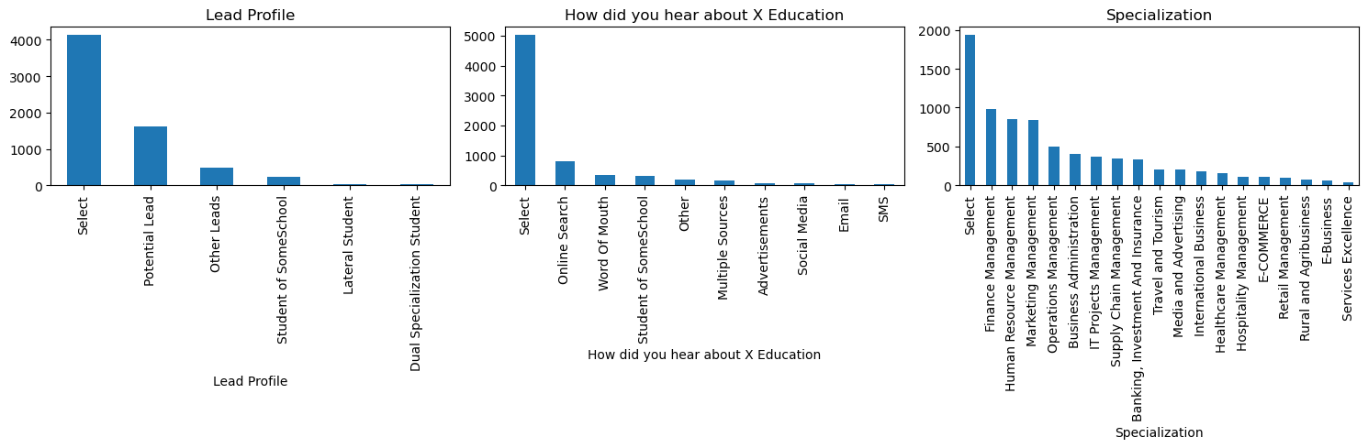







Data Cleaning
◆ columns in which there is a level called 'Select' which is taking care

Slide 7




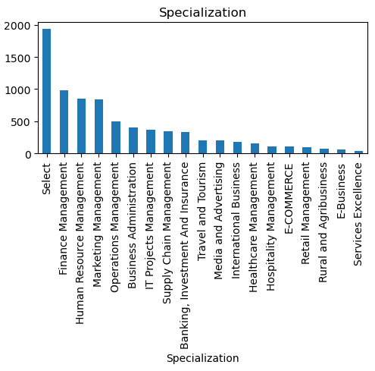





Specialization
Leads from HR, Finance & Marketing management specializations are high probability to convert

Slide 8


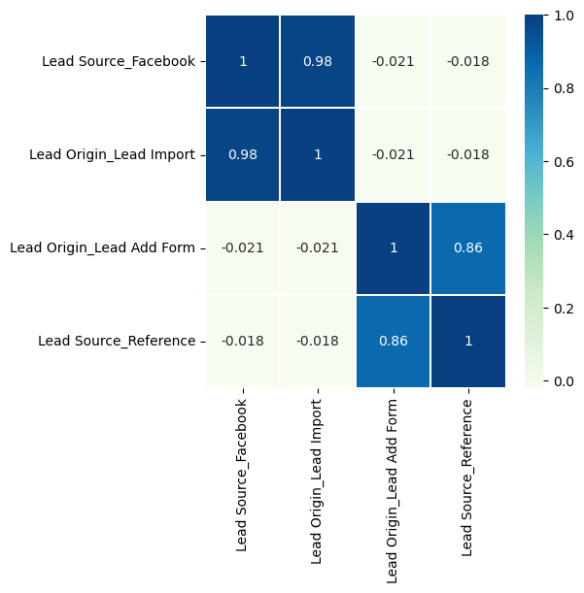







Correlation
'Lead Origin_Lead Import' and 'Lead Origin_Lead Add Form' These predictor variables above are very highly linked with each other at the diagonal (0.98 and 0.85), thus we drop one of them from each pair because they will offer little value to our model.

Slide 9





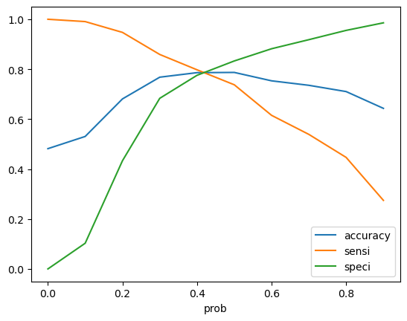
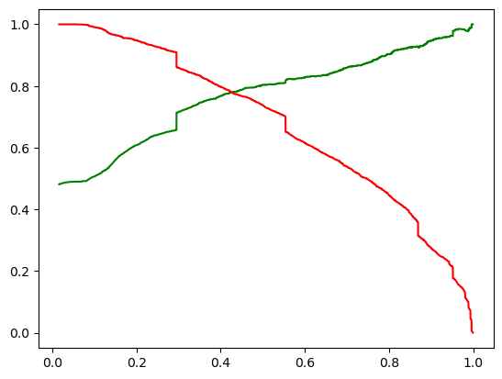




Model Evaluation
ROC curve
0.41-0.42 is the tradeoff between Precision and Recall -
Thus we can safely choose to consider any Prospect Lead with Conversion Probability higher than 42 % to be a hot Lead

Slide 10









Observations
Train Data:
Accuracy : 78.79%
Sensitivity : 78.5%
Specificity : 79.06%
Final Features list:
◆ Last Notable Activity_Unreachable
◆ Lead Source_Google
◆ Last Activity_Had a Phone Conversation
◆ Lead Source_Welingak Website
◆ Total Time Spent on Website
◆ Lead Source_Reference
◆ What is your current occupation_Working Professionals
◆ Lead Source_Referral Sites
Test Data:
Accuracy : 79.28%
Sensitivity : 78.49%
Specificity : 80%

Slide 11









Conclusion
◆ We see max number of leads are generated by Lead Source_Welingak Website. Max conversion ratio is by reference and welingak website.
◆ Leads who spent more time on website, more likely to convert.
◆ Most common last activity is email opened. highest rate = SMS Sent. Max conversion with working professional.

